Slide 1
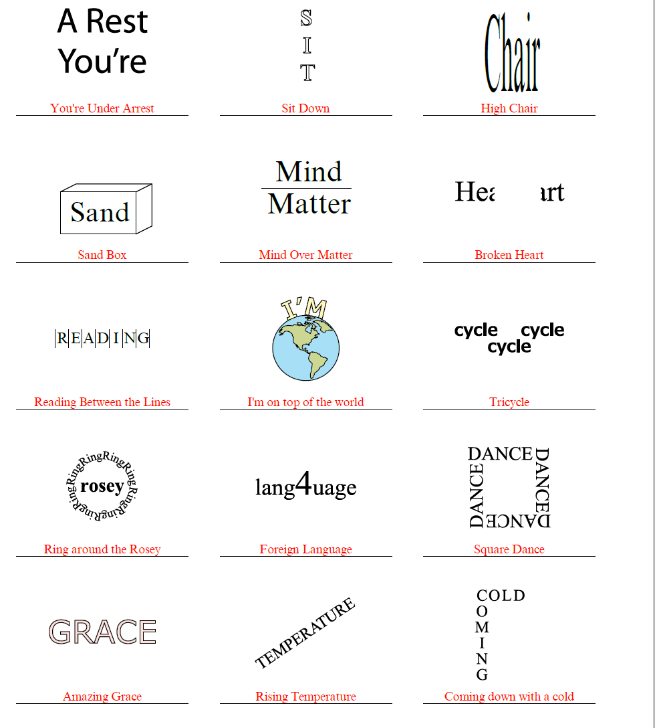

Slide 2
Why does this relate to data science?
Notes:
Identifying patterns is important in data science

Slide 3
Data Science for Everyone WOW Project

Slide 4

What’d we do????
50 people surveyed
Asked about movie and music preferences

Slide 5
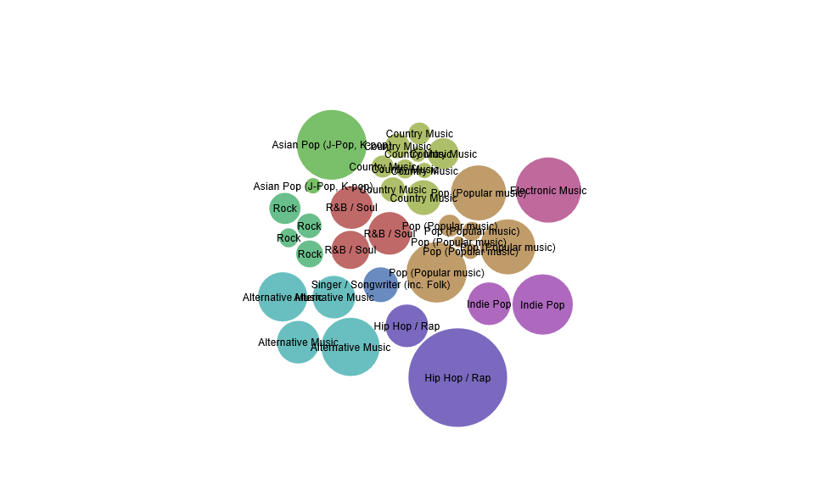
What genre of music people like by how long they listen to music a week

Slide 6
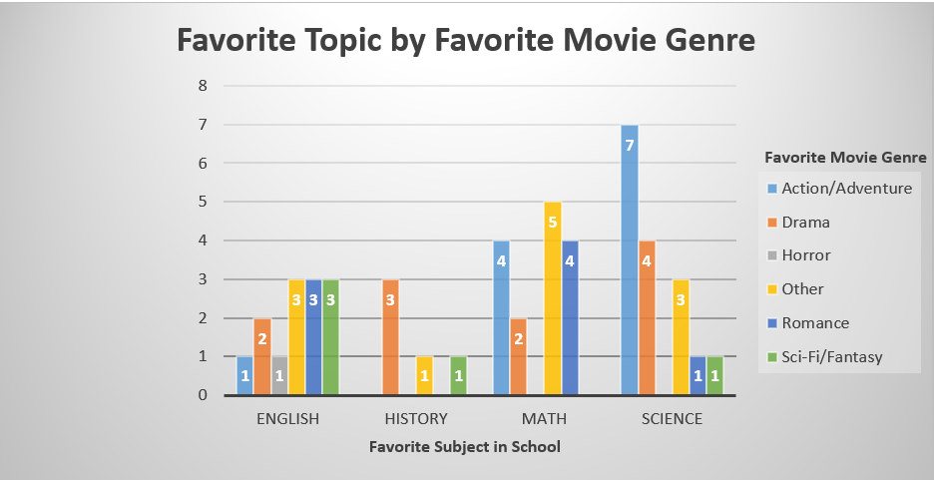

Slide 7


Slide 8


Slide 9
Data Visualizations
Heather Shapiro
Technical Evangelist
@microheather

Slide 10


Slide 11
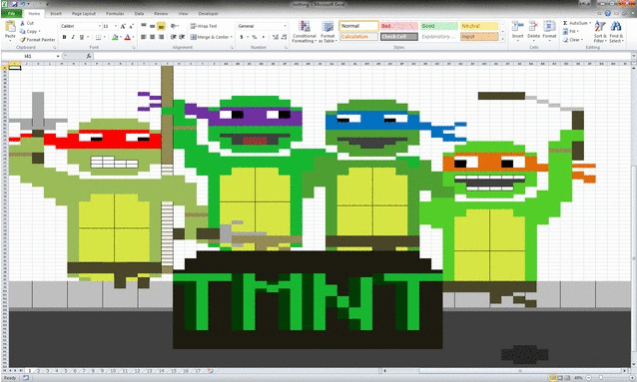

Slide 12
DEMO

Slide 13
App.raw.densitydesign.org

